Slide 1
TRAFFIC FLOW MODELLING: A DISCRETE MATHEMATICAL MODEL
MTH 426A GROUP PROJECT
PROJECT BY-
ABHINAV MEHTA
ANURAG SIROLIYA
GAGAN AGRAWAL
HARSH RAI
VIVEK KUMAR

Slide 2
WHY THIS PROJECT ?
  When do traffic jams emerge?
  Can we predict given certain demand levels, when queuing will occur, how long the queues will be, how they will propagate in space and time and how long will it take for the congestion to be resolved?
  Why does an overloaded traffic network underperform?
  This project gives a basic introduction to traffic flow theory which can help to answer these kinds of questions.

Slide 3
PROBLEM STATEMENT
To model the flow of traffic on a one lane roadway. We can use two types of possible models:
  Cellular automata: Follow individual cars, give rules for motion
  PDE: Ignore individual cars, consider average densities
We have used PDE approach in our model.
Formulate a model for the density ϼ(x,t) of cars per unit length, as a function of position x and time t, given the initial density ϼ(x,0) and ϼ(0,t).
Using MATLAB to solve the PDE through finite difference approach and plotting a map of the traffic density at a given position and time.

Slide 4
SYSTEM CHARACTERIZATION
Closed System with cars and one-way road as objects.
Ignoring the effect of any external agent(no environment).
Variables: Density of cars, Flux of cars, distance, time and velocity of cars.
Parameters: Length of the car, distance between the two, width and length of the road .
Deterministic as we can predict the motion of the cars over time without much error.
Discrete: Using discrete time and distance intervals in the finite difference method to solve the PDE’s .The time of discretization is 500 milliseconds.
Dynamic: The density and flux which are the system variables depend on time.

Slide 5
ASSUMPTIONS OF THE MODEL
Firstly we are ignoring individual cars but instead we are using density of cars:
  Number of cars are assumed to be infinite.
  As we need an assumption on how density is averaged, we take ∆x→0 be in the limit.
Considering that motion is directed left-to-right on a one-lane roadway of finite length.
Assume all cars have the same length L and they are evenly spaced at distance d. This is the uniform distribution model.
All other effects such as accidents, stopping at speed-breakers, construction, weather, etc. are ignored here.

Slide 6

MATHEMATICAL FORMULATION
Uniform Distribution Model
Consider the interval Ix0 = {x0 - ∆x < x0 < x0 + ∆x} about the point x0.
Density of cars,
ϼ(x0,t0) = (1/(2∆x))*(no. of cars in the interval I_{x0} at time t = t0) ………(1)
The assumption is cars have length L and uniform spacing d. Using (1) we find that:
since the number of cars in the interval I_{x0} is 2∆x/(L+d) .

Slide 7


Note that since 0 ≤ d <∞ and L is infinite that there is a maximum density:
How many cars pass the point x0 per unit time?
To find the flux of cars through x0 at time t0, we counted the number of cars passing x0 during the time interval
and divide by the interval length. In other words,
The assumption on ∆t is that it is small enough so only cars passing by near time t₀ are counted, but big enough so that many cars pass through. In the continuum limit, ∆t →0.

Slide 8

Assuming that the cars move to the right with constant velocity v.
During time 2∆t, cars move a distance equal to 2v∆t, hence the number of cars passing a point x₀ during this time is ϼ×distance = 2v∆t/(L+d) :
Using (2), the u_{x} about x₀ at time t₀ is
Here, we can see that J = ϼv .

Slide 9
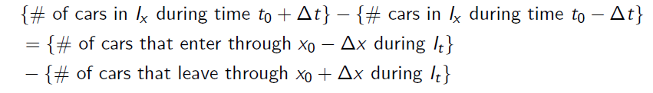
EXTENSION OF THE TRAFFIC FLOW MODEL :Balance Law for Density
The previous model is extended to allow for changes in density. This is accomplished by using a control volume (CV) and accounting for all the ways the density can change in the volume.
Assumptions: cars cannot enter through the top or bottom (no ramps), cars enter from the left and exit from the right (one way traffic).
Consider the CV consisting of the interval Ix during the time interval I_{x} . The idea is simple, the net change of cars in Ix during It is equal to the net u_{x} of cars through the boundaries during this time. In other words:

Slide 10

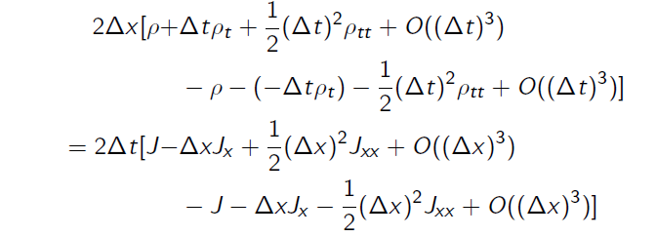
In terms of density and u_{x}:
The goal is, as before, to take ∆x, ∆t→0 to deduce the continuum limit. This is accomplished by expanding ϼ and J in Taylor series and considering the leading order terms.
By Taylor expanding we find that (about the point (x₀,t₀)):

Slide 11
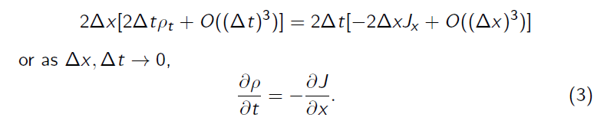

This reduces to:
If the u_{x} function J is known, then (3) tells us how ϼ evolves. This is usually deduced empirically.
Instead focus on v. Assume J = ϼv as before, where v = v(x; t) is the average velocity of the cars at (x,t).
The PDE model for traffic flow then reads:

Slide 12
Remarks
PDE can now be solved analytically or numerically.
BUT, the PDE model is an approximation! Discrete traffic flow has been modeled by continuous density.
Low densities are therefore a problem. We don't expect the PDE to hold when there are few cars on the road.
The velocity v is still needed. We need a constitutive law relating v to ϼ. This can be obtained by examining the physics or determined from empirical evidence.

Slide 13


FINITE DIFFERENCE APPROACH AND ITS COMPUTATION IN MATLAB
Let us return to our model,
Denote ϼ (xj,tn) = ϼ_{j}^{n}
Use the forward difference to approximate the time derivative and the backward difference to approximate the spatial derivative:
Thus we have approximations of the two derivatives, which will approach continuous equations in the limit as ∆x → 0 and ∆t→0.

Slide 14

Thus our numerical scheme is:

Slide 15
COMPUTATIONS USING MATLAB
function [rho] = traffic()
%-----------variables--------------------
time_range = 5;
x_range = 10;
div = 100;
rho = zeros(x_range*div,time_range*div);
a = 1;
%----------------------------------------
%----------initial condition-------------
for i=2:x_range*div
rho(i,1) = 0;
end
%rho(1,1)=1;
%---------------------------------------
%---------boundary condition------------
for i=1:time_range*div
rho(1,i) = 1;
%temp = (time_range*div+1-i);
%rho(1,i) = int32(100*temp/(time_range*div));
end
%--------------------------------------
%updation of density in the matrix
for i=2:x_range*div
for j = 2:time_range*div
rho_l = rho(i,j-1);
rho_p = rho(i-1,j-1);
%rho(i,j) = rho(i,j-1)-a*(rho(i,j-1)-rho(i-1,j-1));
rho(i,j) = rho_l-a*(rho_l-rho_p);
end
end
%---------end of for loop----------------
imagesc(rho);
end

Slide 16
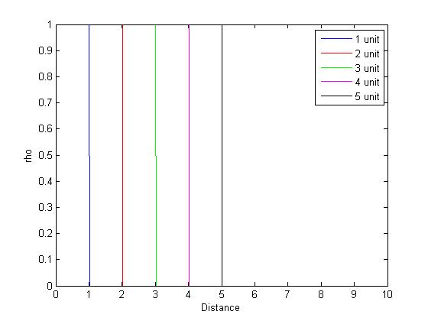

Slide 17
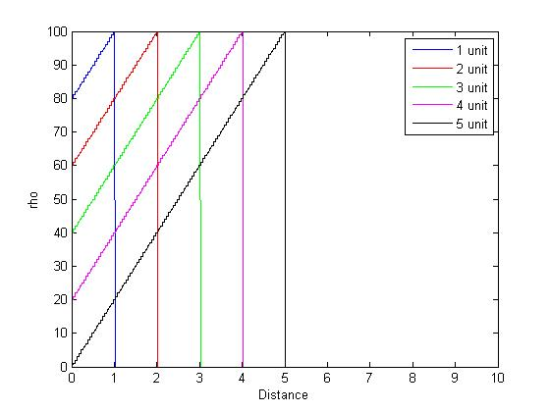

Slide 18
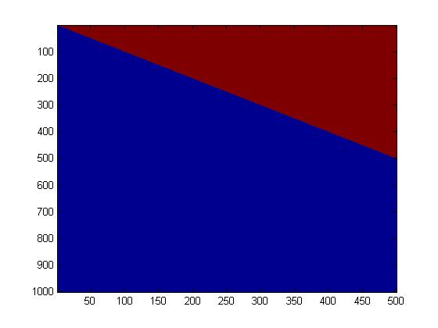
This is a 3D graph with negative y-axis as distance , x-axis as time and the color as the representative of density. The blue color is for zero density and brown color is for unit density. As the cars with constant unit density travel from zero distance, we observe the above plot.

Slide 19
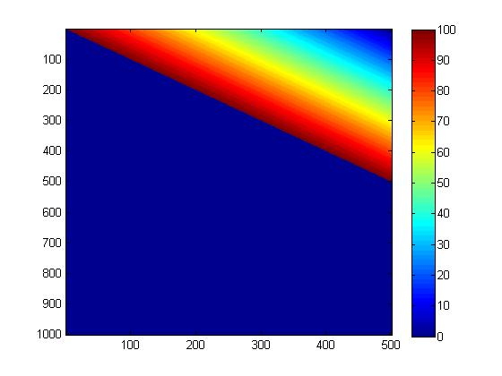
This is a 3D graph with negative y-axis as distance , x-axis as time and the color as the representative of density. The blue color is for zero density and lighter colors for higher density. As the cars with linearly decreasing density travel from zero distance, we observe the above plot.

Slide 20
CONCLUSION
We discussed a PDE model for traffic flow.
The model is solved using a finite difference scheme, and implemented on MATLAB.
We have plotted the graphs for density versus distance and time for initial conditions that are constant initial density, linear initial density, constant velocity as well as separately for variable velocity.

Slide 21



MODIFICATIONS
For a more realistic model, we assume a linear velocity for cars.
It can also be written as :
Using this form of v in our PDE we get that now,

Slide 22
LIMITATIONS
We have ignored many effects mentioned earlier, for instance, intersections, weather, traffic lights, etc.
Perhaps our guess on velocity was too restrictive. A form such as v = F (ϼ, ϼ _{x}) may be better.
For highway travel, merging and multilane effects become important.
The models presented seem to work only for light to heavy traffic situations.

